Slide 1
Now till now we have developed the backend

Slide 2
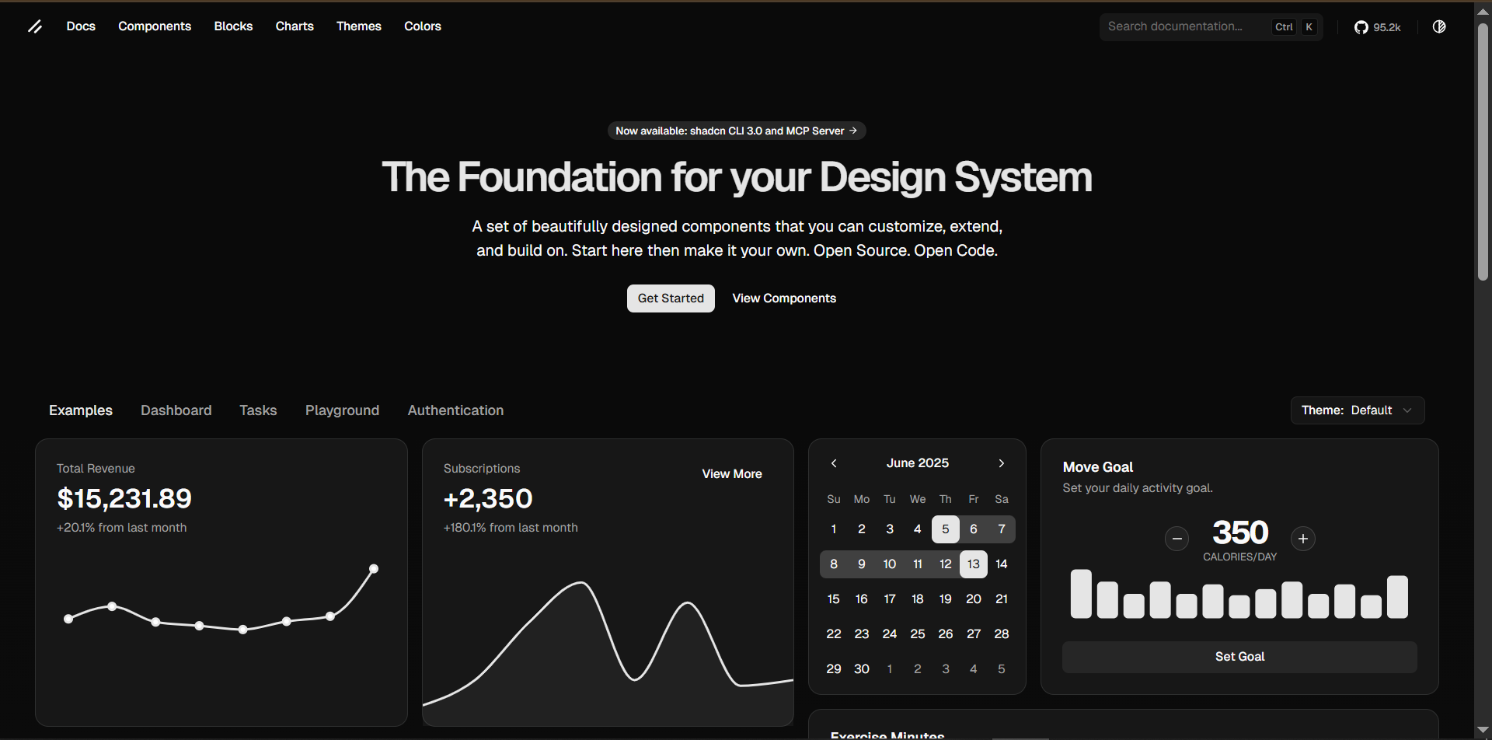
ShadCnui

Slide 3
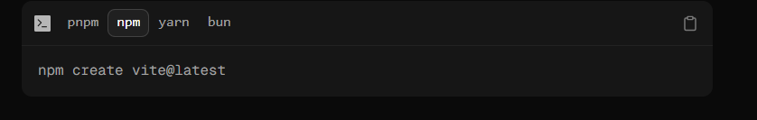
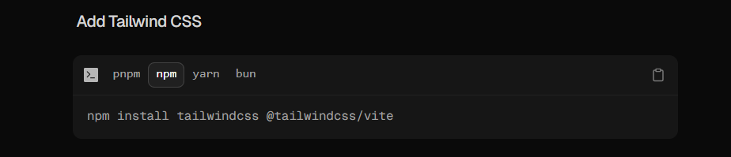

Slide 4
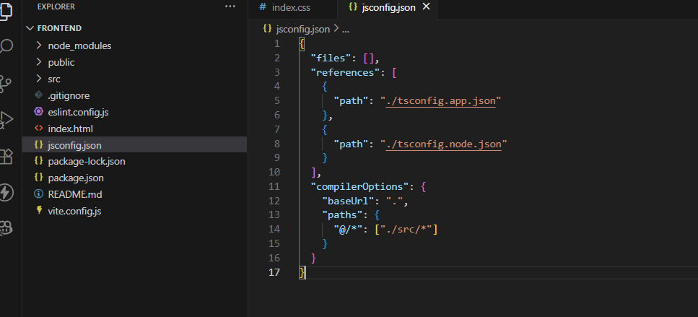

Slide 5
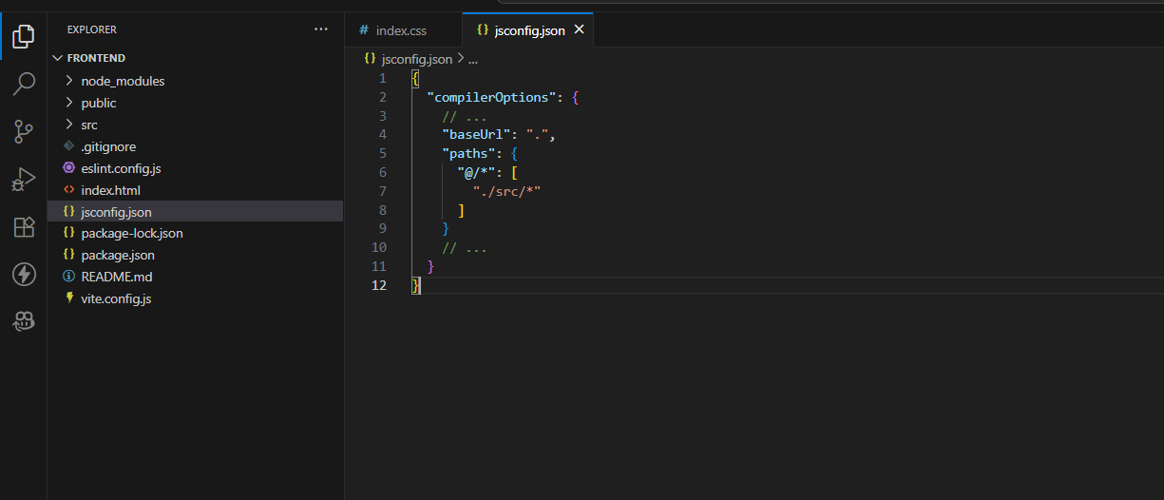

Slide 6
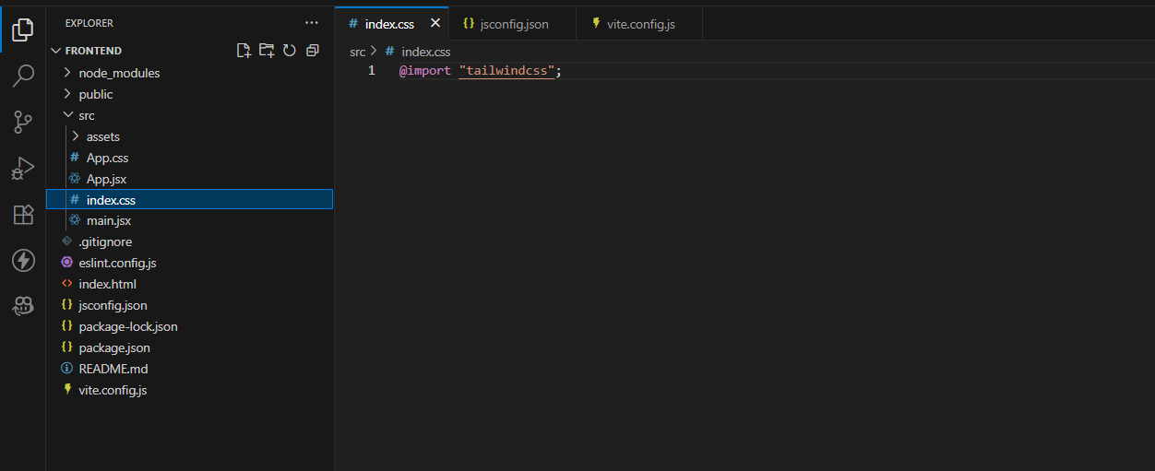

Slide 7
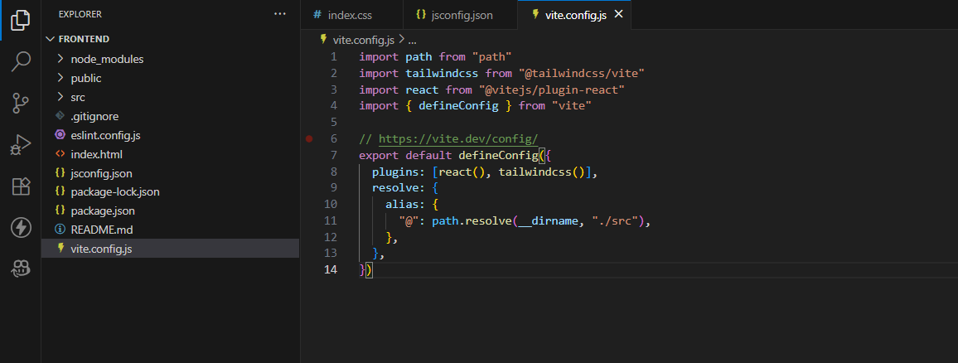

Slide 8
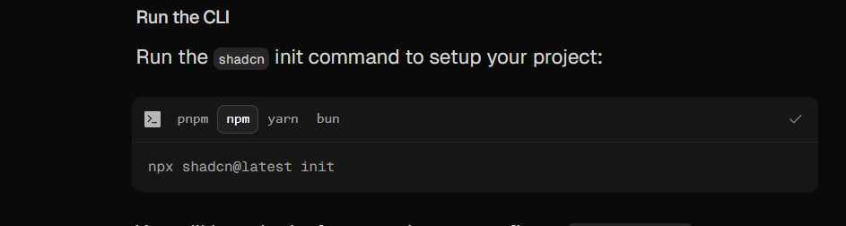

Slide 9
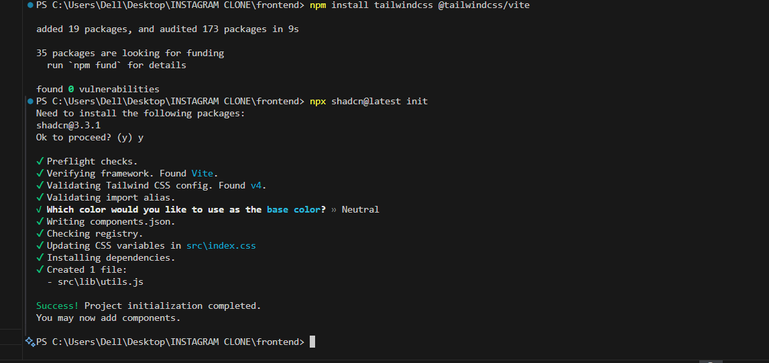

Slide 10
Now after adding all these…
We can start adding components in our project and start using shadcn ui components

Slide 11
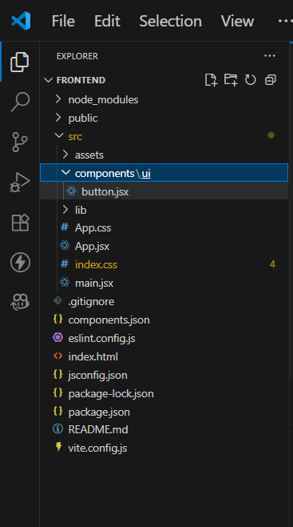
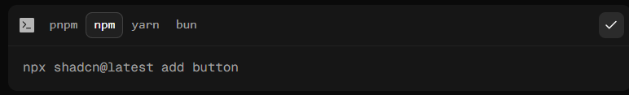
Adding button

Slide 12
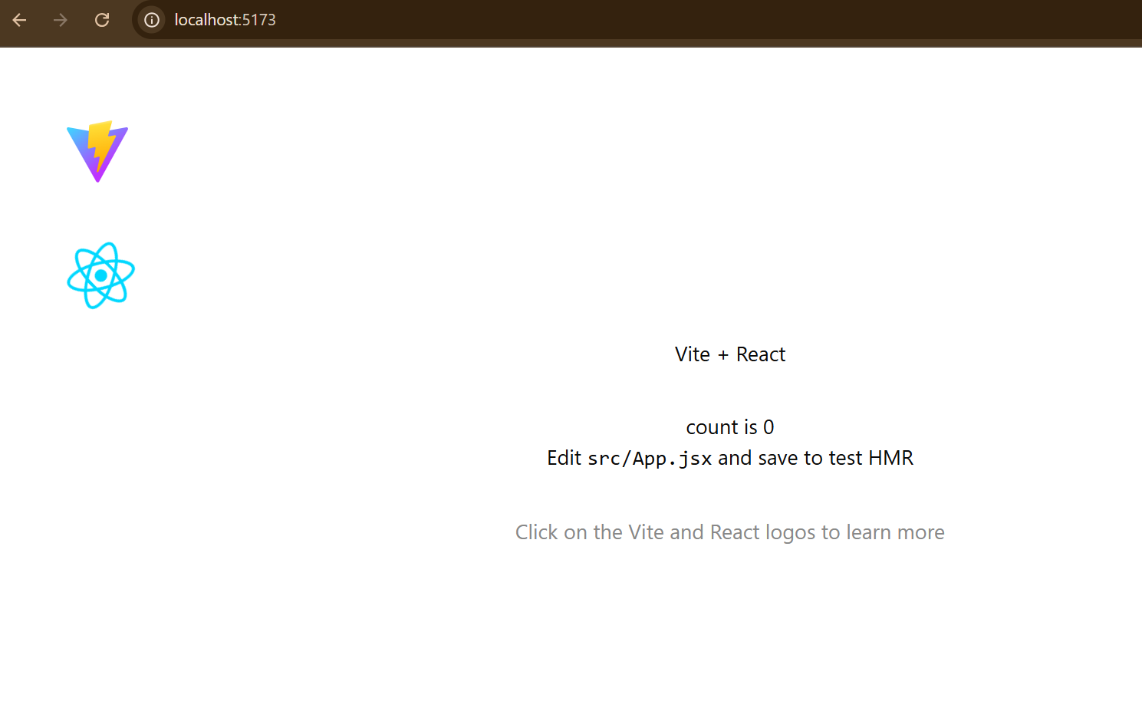
Sample running of localhost:5173

Slide 13
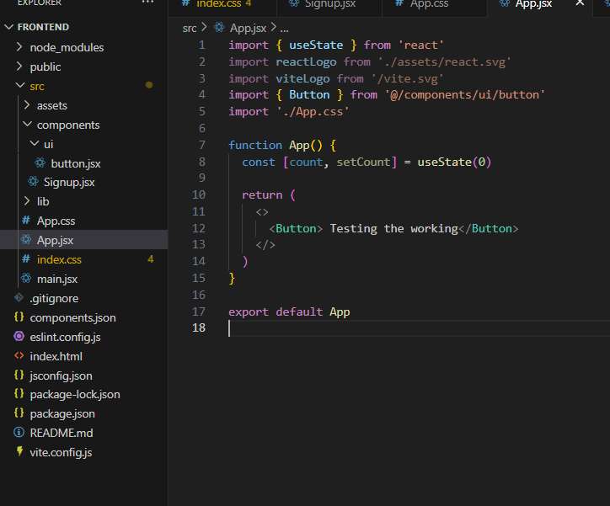
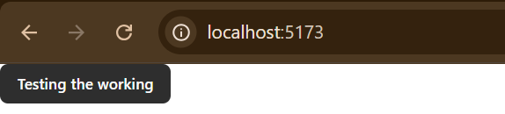
Testing the button working

Slide 14
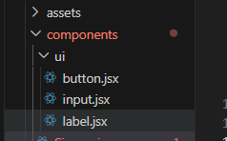
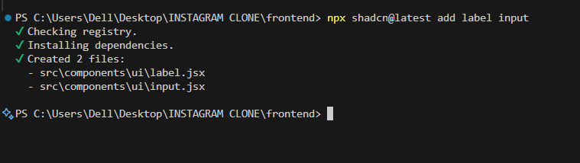

Slide 15
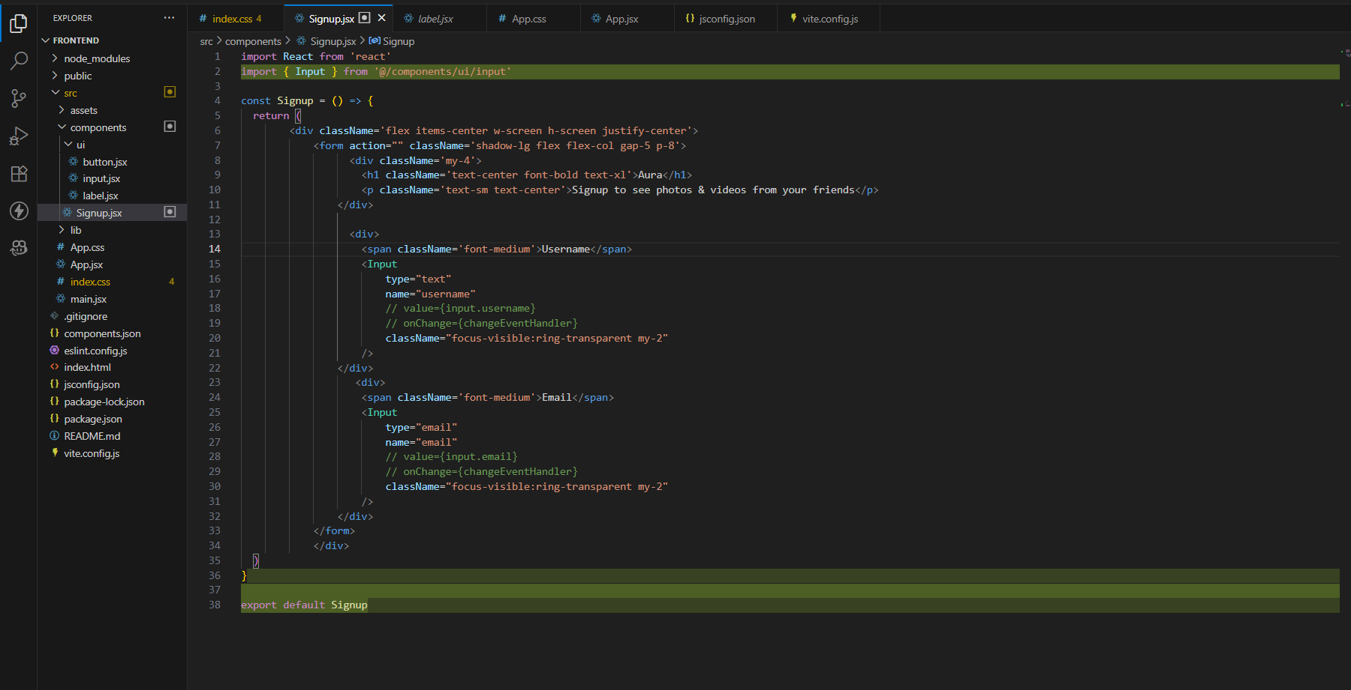
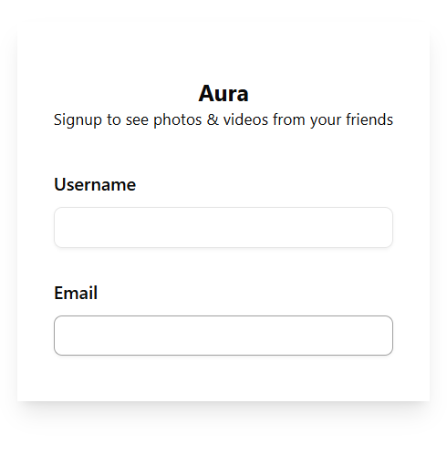

Slide 16
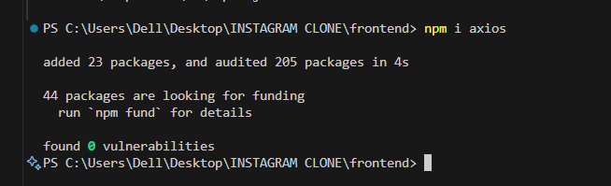
Supports GET, POST, PUT, DELETE, etc. Handles JSON automatically. Allows setting custom headers and interceptors. Works with async/await for cleaner code.
Axios is a popular JavaScript library used to make HTTP requests from the browser or Node.js. It supports promises and async/await, making it easy to fetch data from APIs, send data to servers, and handle responses and errors.

Slide 17
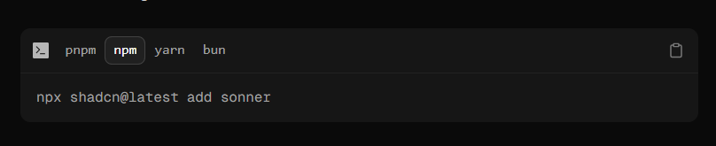
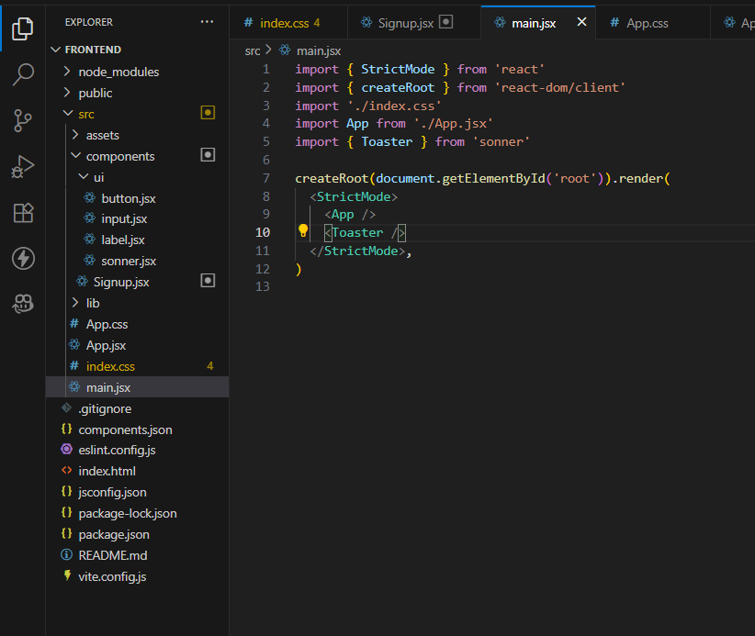
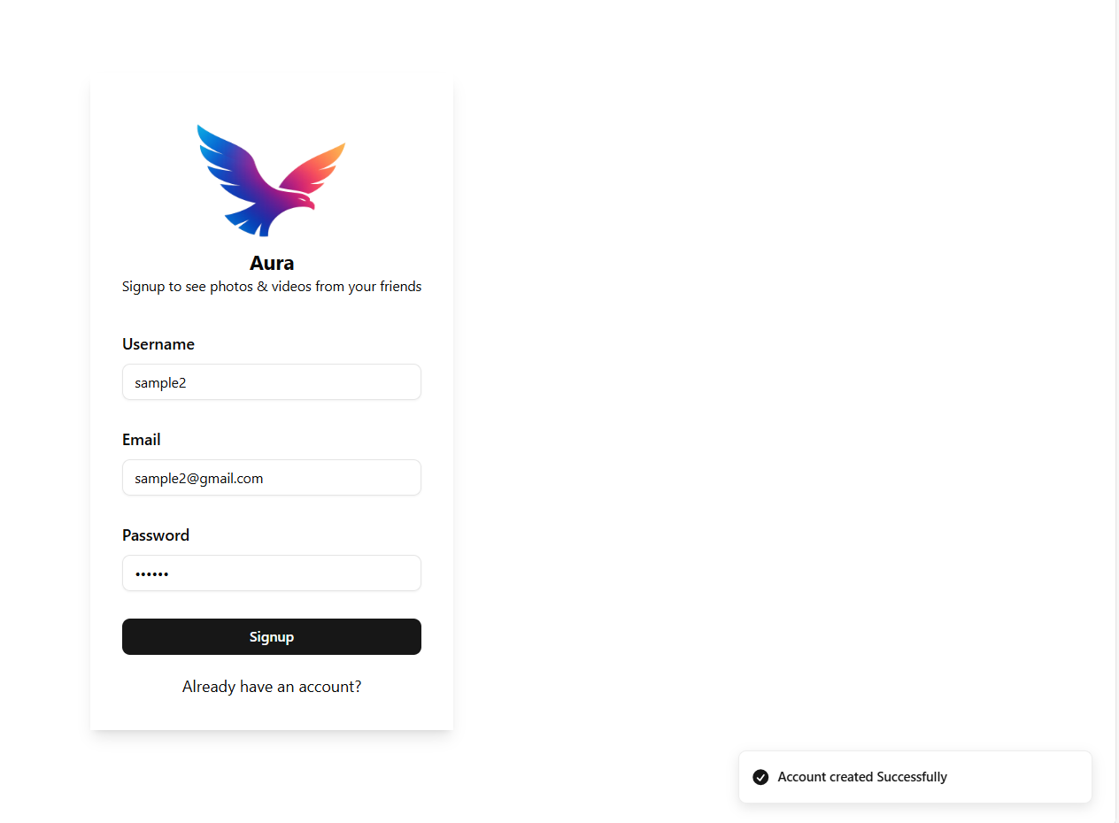
Sonner
Sonner has a comment
called Toaster
To make sonner work..
We need to attach Toaster in the
Main.jsx

Slide 18
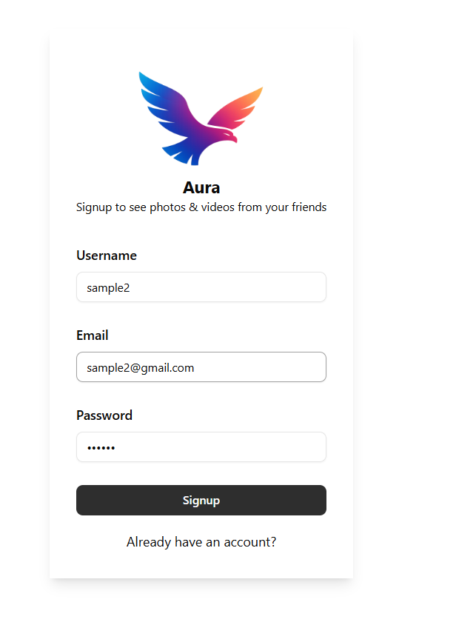
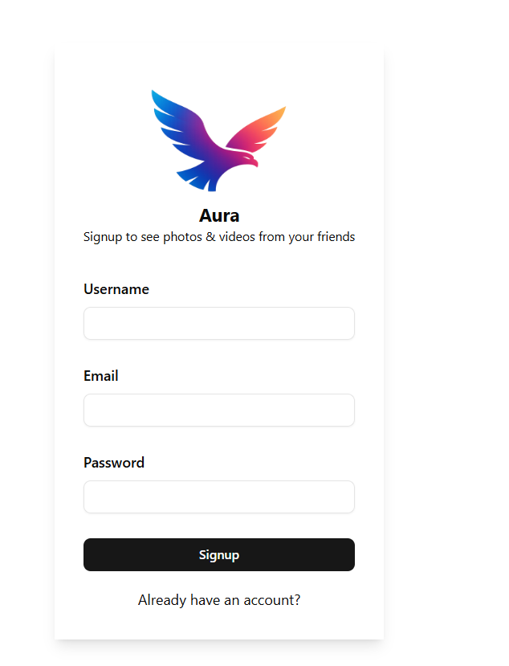

Slide 19
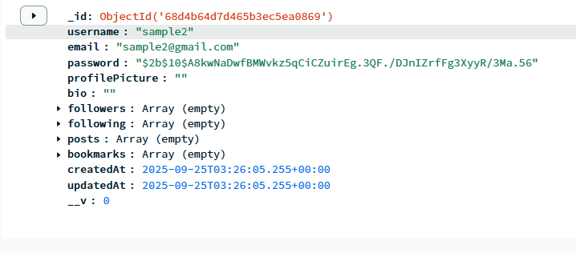

Slide 20
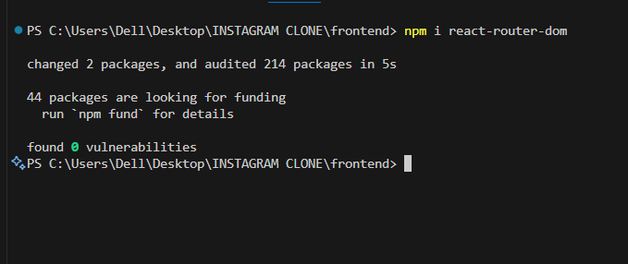
Now we are implementing react router dom
React router dom is simply used when we are implementing
Going from one page to anther in our project

Slide 21
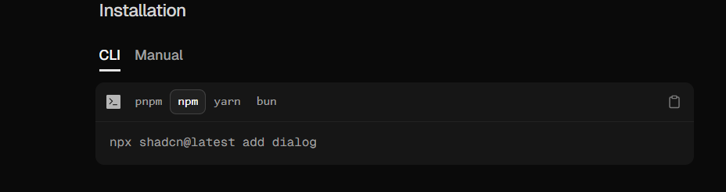
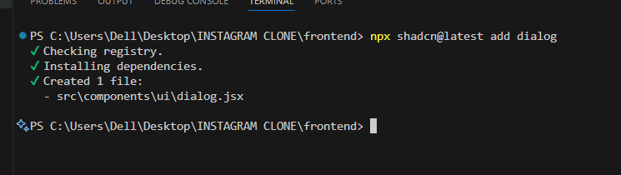
Dialog – shadcn ui component

Slide 22
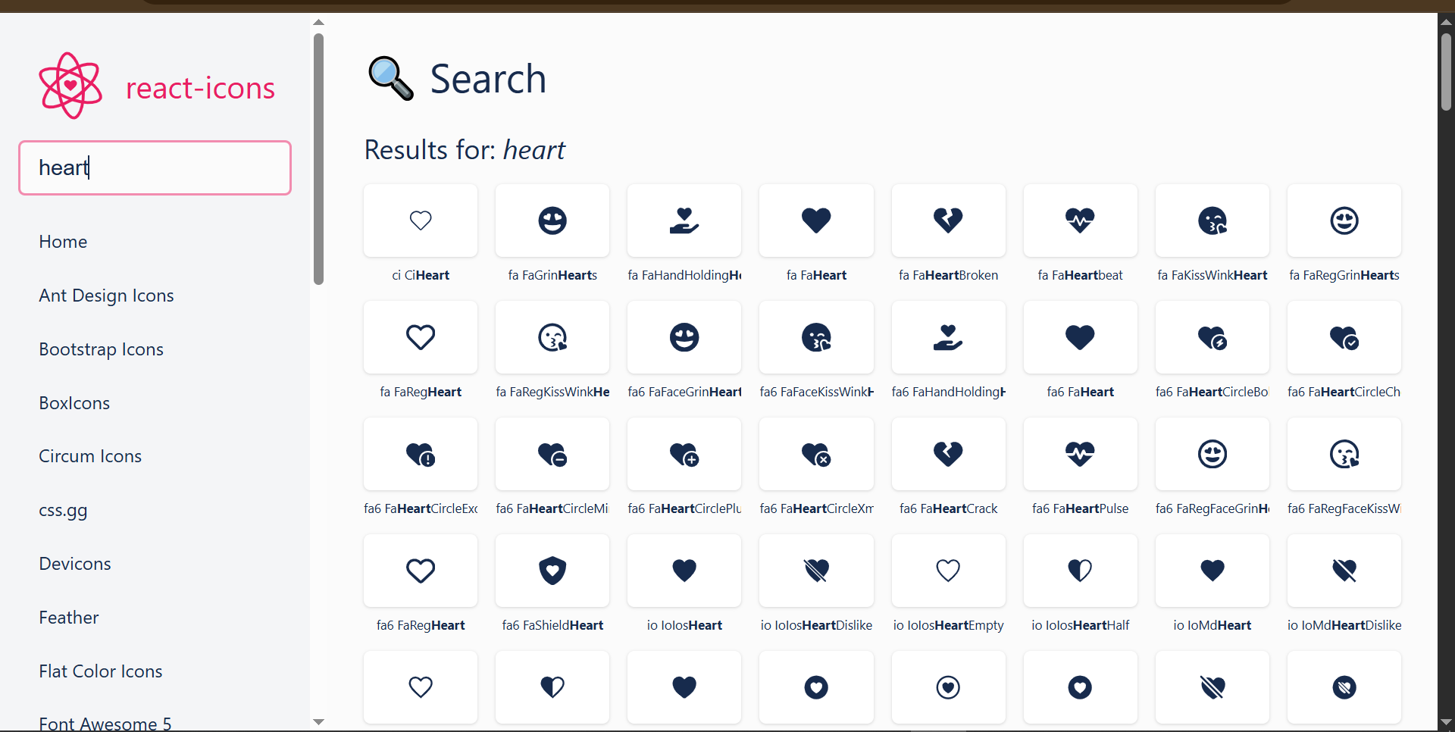
import { FaHeart } from "react-icons/fa";

Slide 23
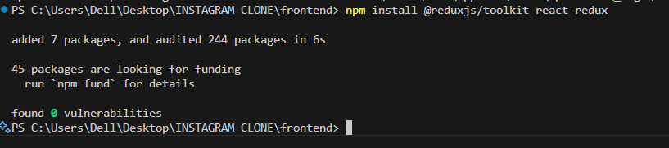
React has a problem of state management
So for that ..we are using redux– redux is used for global storage

Slide 24
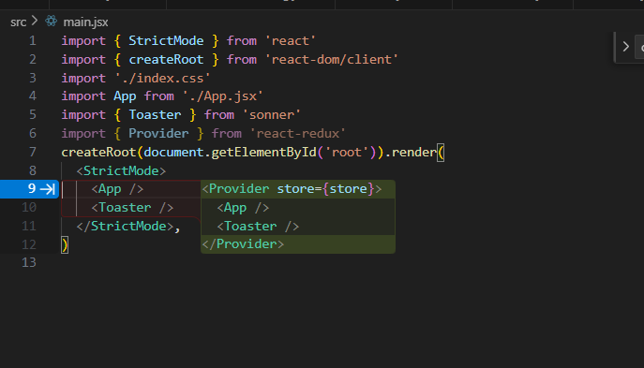

Slide 25
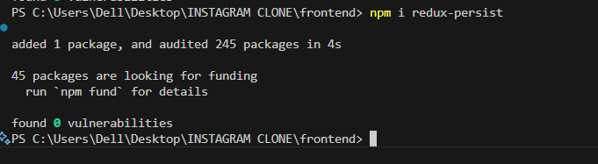
Redux persist

Slide 26
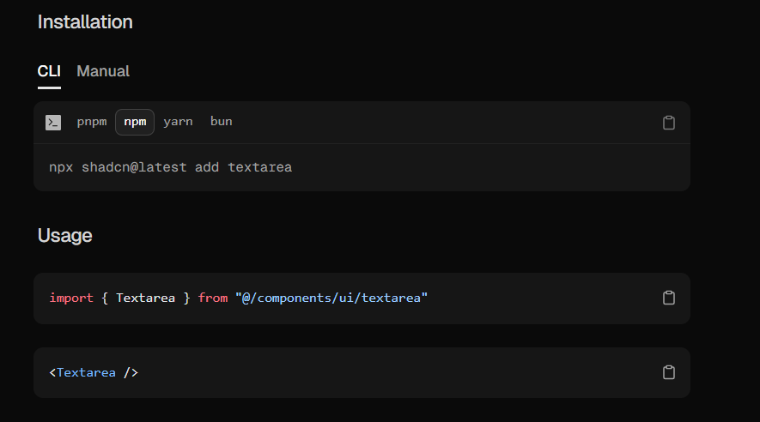
TextArea -- ShadCnui

Slide 27
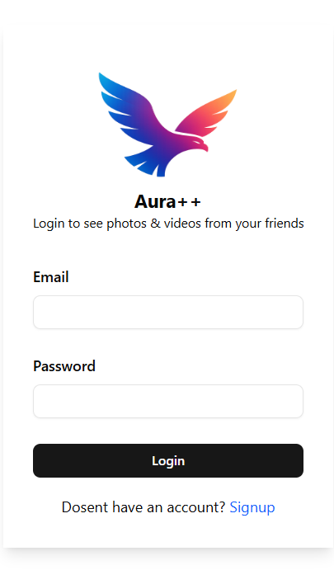
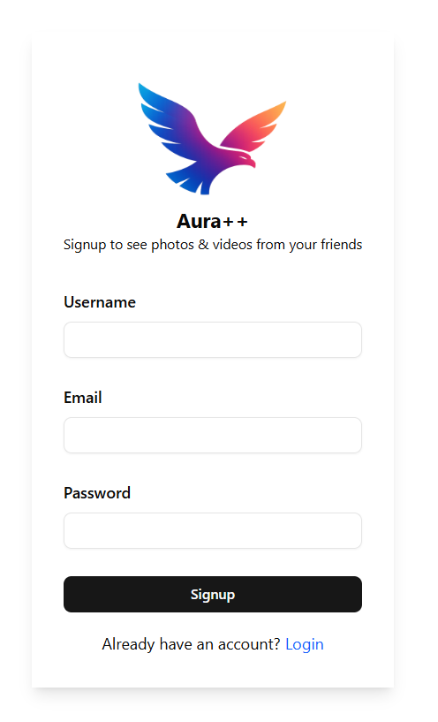
Signup.jsx

Slide 28

Now implementing socket io

Slide 29
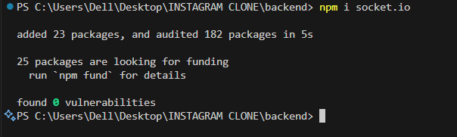
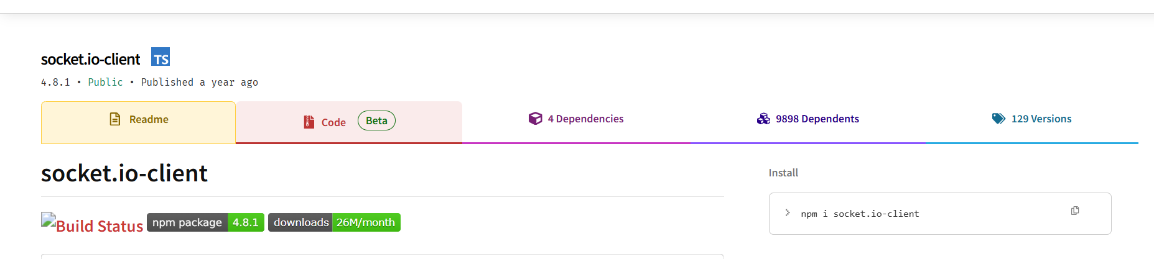
Now we have installed the socket io for the good work….

Slide 30
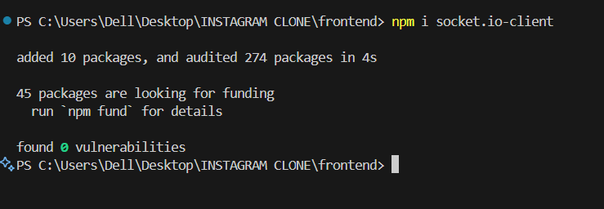
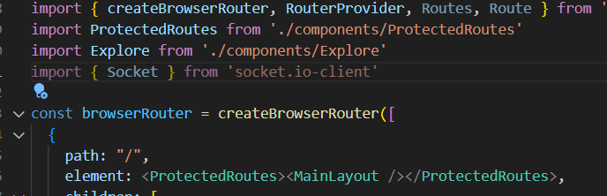

Slide 31
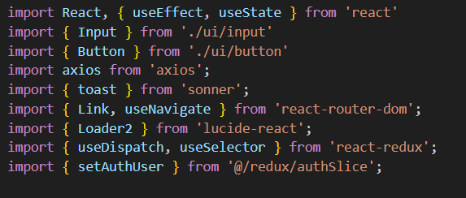
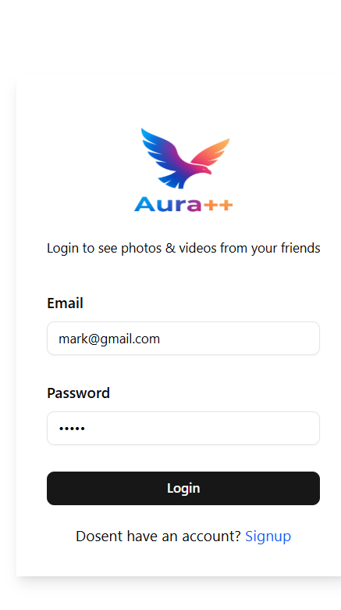

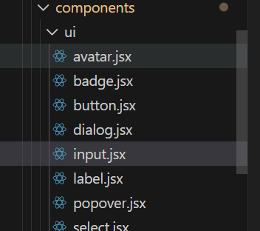





















Login page
Import React and the `useState` hook for local component state
Input UI primitive used for email/password fields.
HTTP client for sending the login request to the backend.
for client-side navigation, useNavigate to programmatically navigate.
INPUT AND BUTTON ARE COMPONENTS FROM
SHADCNUI

Slide 32





REDUX – BIG STORAGE BOX FOR THE APP
APP STORES DATA IN BOX – EXAMPLE THE USER LOGIN INFORMATION
ANY COMPONENT CAN TAKE THE DATA OUT
ANY COMPONENT CAN UPDATE THE DATA
useSelector = a function that lets you READ data from Redux store
useDispatch – it is a function that lets you
send the data in redux
It is an action creator.
it creates an action → something that tells Redux what to update.
🟦 1. useDispatch()
To send actions to Redux → update global state.
🟩 2. useSelector()
To read data from Redux → get global state.
🟧 3. setAuthUser (action)
Tells Redux what to update (here: update user).

Slide 33
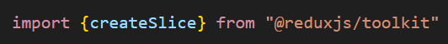




Authslice.js ---- this is a redux file
For example we have used certain variable states like the user profiles, user suggestions and various other things..like we are using them as global variable..so for that..we have to use redux..
This is the authslice.js file ---- basically for storing the authentication information of the user
It manages authentication-related state (user, profile, suggestions).
This is importing redux toolkit function
createSlice → helps you create:
State
Reducers
Actions
All in one place.

Slide 34
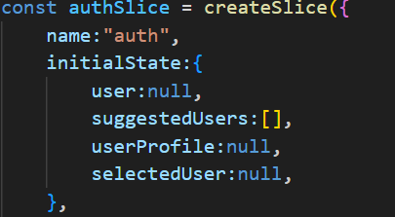

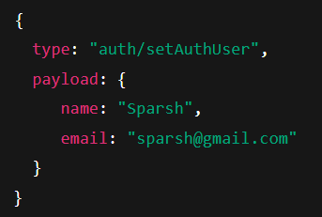
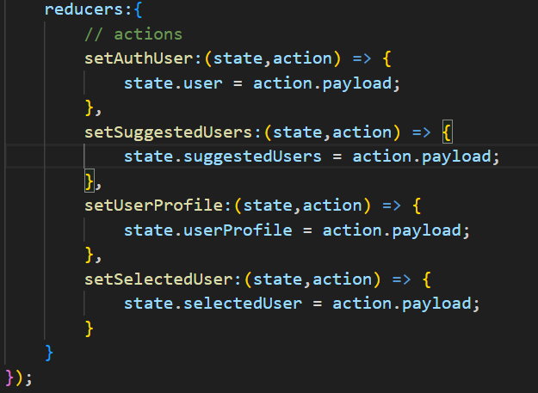








Creating the slice
This slice will be stored under the key auth inside the Redux store.
The slice will be store as store.auth
This is the initial login information
Like before the login..the state looks like it
Whenever we do dispatch..we send some data with it
And the action == full object
But action.payload is the data we send
Action Name | What it does
setAuthUser | Set logged-in user
setSuggestedUsers | Update suggested users list
setUserProfile | Set the profile being viewed
setSelectedUser | Set user for messaging/chat

Slide 35
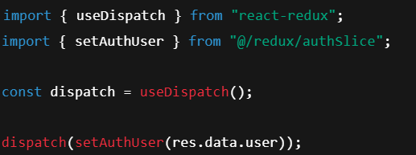

great..now till now ..we have maken the authslice.js file..which is basically the redux file ..and we have created the functions
The redux file is like a recipe book from where we sees and go actions
Similarly if we want to use the authslice..we need to use the dispatch method – like dispatch(setAuthuser(user)) --- like this type of method..we need to use

Slide 36
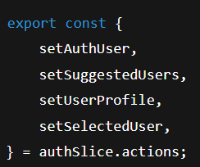
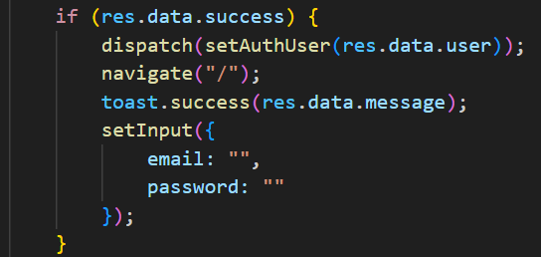



After creating the redux state..we will export it ..
so that we can use it anywhere using the dispatch items
This gives us functions to update the store anywhere:
dispatch(setAuthUser(data))
dispatch(setSuggestedUsers(data))
dispatch(setUserProfile(data))
dispatch(setSelectedUser(data))
This is the login page--- here we used the dispatch method
To set the login information of the user
Exporting the reducer
export default authSlice.reducer;

Slide 37
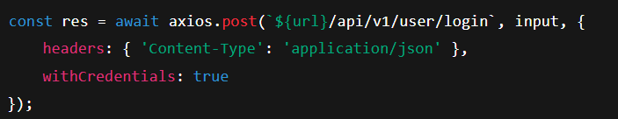






store = Redux store (global storage)
store.auth = auth slice (because slice name = "auth")
store.auth.user = the user inside initialState
With the help of axios ..we send the data to backend
axios.post(url, body, config) means:
url → Where to send request
body → What data to send
config → Extra settings (headers, cookies etc.)
Axios is a library used to make request to the backend
This function runs everytime when we type in
The input box
… input ---- it means keep the old values
Like for example we type password…then the email
Should be there..this work is done by this …input
This is the part of react Router dom
Use for navigation after login
This hook allow us to use dispatch function
Whenever we refresh the page..react will check whether we are logged in or not
And if we are login..it will redirect us to the home page

Slide 38


Now till now we have created the login page //now we are creating the signup page
These are shandcn ui components
This is the loader ..same as in login page
Axios are used to send request to
Backend with data
This sonner is the popover component
All the things are similar just like in the login page

Slide 39




Now building the home page
So there are different sections in our page
We will divide each section and start working
Section by section
RightSidebar

Slide 40

Home.jsx
This feed is the main component showing posts
This outlet is a placeholder
where Child routes are shown
It is used for feed where
There is changing posts
These are custom hooks to fetch all the users are suggested users
fetch posts
fetch suggested users
store them in Redux
update UI

Slide 41

useGetAllPosts.jsx --- inside the hooks folder
This is use to get all the posts from the backend
Stores them in the redux and automatically runs
When the home page runs
…later on we have added the public and private
Posts system ….
Redux posts has a postSlice.js file..
So the main thing that happens is the dispatch function
Tell the redux to store the posts
And will display them
When the useGetAllPost hook runs, it fetches all posts from the backend using Axios. If the request is successful, it calls dispatch(setPosts(res.data.posts)). This dispatch sends the fetched posts to the Redux store, where the postSlice updates its posts array with the new data. Because Redux stores this data globally, any component in the app can access the posts using useSelector, without needing to fetch them again. This makes the app faster, avoids repeated API calls, and ensures every component always displays the latest posts.

Slide 42

postSlice.js
🎯 What is createSlice in Redux Toolkit?
createSlice is a shortcut function that helps you create:
State (initial data)
Actions (functions that update the state)
Reducer (the logic that Redux uses to modify the store)
All in one single place, instead of writing long and complicated Redux code.
Slice in redux store will appear as store.post
Posts array (initially empty)
Used in CommentDialog
Where see details of a specific post
Reducers are the function that update the state
❤️ ACTION = TRIGGER + DATA
setPosts()-- an action used to store all posts in Redux.
setSelectedPost()-- an action used to store only one selected post.
Export the reducer so that store
Can need that

Slide 43

useGetSuggestedUsers.js --- inside the hooks folder
Authslice.js file me suggestedUsers array hai
This custom hook useGetSuggestedUsers automatically runs when the page loads using useEffect. It sends a GET request to your backend /api/v1/user/suggested using axios to fetch a list of suggested users. The dispatch function from Redux is used to store those users in the global state by calling the setSuggestedUsers action from authSlice. The hook also handles authentication errors and logs problems if the request fails. In short, this hook fetches suggested users once, and saves them in Redux so any component (like the right sidebar) can display them.

Slide 44

RightSidebar.jsx
UI components to display profile picture.
Avatar, AvatarImage, AvatarFallback → UI components to display profile picture.
useSelector → Reads data from Redux store.
Link → For navigation without refreshing page.
SuggestedUsers → Shows the list of suggested users.
We go to Redux store → auth slice → user. This gives us the logged-in user details (username, image, bio, id, etc).
AvatarImage - shows user's real profile picture
AvatarFallback - shows a default image ONLY if picture fails to load (your fallback is actually still loading the picture again or default /profile.jpeg

Slide 45

SuggestedUsers.jsx
useSelector → read data from Redux store
useDispatch → send actions to store
Link → navigate to user profile
axios → make API call
toast → popup messages
setAuthUser → update logged-in user in store
setSuggestedUsers → update suggestions list
suggestedUsers → list of users suggested
authUser → currently logged-in user
Both come from authSlice.
The handleFollow function is responsible for following or unfollowing a user and instantly updating the UI. When the follow button is clicked, it sends a request to the backend using Axios to the /followorunfollow/:id route, which returns whether the action performed was a follow or an unfollow. Based on this response, the function updates the logged-in user (authUser) in Redux by either adding the target user’s ID to their following list (if followed) or removing it (if unfollowed). If the user was just followed, the function also removes that person from the suggestedUsers list in Redux so they disappear from the suggestions instantly without needing a page refresh. Finally, it displays a toast message to notify the user of the successful follow/unfollow action, or an error toast if something went wrong.

Slide 46



SuggestedBox.jsx
React: lets you create components.
useRef: used to control and scroll the suggestion box horizontally.
setAuthUser: updates the logged-in user state in Redux.
setSuggestedUsers: updates the suggestions list.
Left and right arrow icons for scrolling the suggestion list.
This hook allow us to use dispatch from react store
Reads data from the Redux store’s auth slice
suggestedUsers → List of users suggested to follow (default: empty array)
authUser → Logged-in user information.
This automatically re-renders the component when auth data changes
Create a reference to html element,
Used for horizontal scrolling
Axios to send data to backend
Update current user (authUser) in Redux
If followed--Add targetUserId to following list.
If unfollowed -- Remove targetUserId from following list.
If we follow someone..the person should disappear from the list

Slide 47








These are the left and right scroll functions

Slide 48

Profile.jsx

Slide 49











Profile.jsx
useState is used to store component-level states like:
activeTab
dialog open/close states (comments, followers, following)
This is used for profile images
This is the custom hook(made by Master sparsh)
This hook is used for fetching the profile data
useParams() → gets id from URL Example: If URL = /profile/123 → params.id = 123

Slide 50

This useParams() – this is use to extract the id from
the url (params)
This is use to get profile details using the id
This is a custom hook
When the user open the profile page..then
Default is posts..and later we can choose the
Saved posts
This is for the remove button , like the owner
(Master Sparsh) can see the remove button
userProfile = data of the profile you're viewing
user = currently logged-in user (from Redux authSlice)
Guard: Prevent Rendering Before Data Loads
These are for comment,followers
and following popups
Check if the user viewing the profile is logged in user or not as if it was logged in user…the user can see the Edit profile option
user.following is an array of user IDs that you follow.
.some() checks if any one of those IDs matches the profile user’s ID.
!! converts value to true/false (boolean).

Slide 51

If the post is private, the user should not see the posts
The user is blocked from seeing the posts if
1)The account is private,
2)The user is not in the following list
3)If you are not the owner
If the post is private, the user should not see the posts
The user is blocked from seeing the posts if
1)The account is private,
2)The user is not in the following list
3)If you are not the owner
it creates a new user object (updatedAuthUser) by copying all the existing properties of the logged-in user using ...user. Then it updates only the following array: if the action is a follow, it adds the profile user’s ID to the array, and if it’s an unfollow, it removes that ID using filter(). Finally, it dispatches
It creates a new object called updatedProfile by copying everything from the existing userProfile using ...userProfile. Then it updates the followers array:
If you just followed them (isNowFollowing === true), it adds your user ID (updatedAuthUser._id) to their followers list.
If you unfollowed them, it removes your ID from their followers list using filter().
When we click on the button ..then it will be for that

Slide 52

It selects either posts or bookmarks depending on which tab is active, making sure the UI displays the correct list.
Basically when we click on the post..the the commentdialog
Will open up
This function is for the owner(Master Sparsh)
The remove button is only shown for the owner..
And the owner can delete it with axios.delete

Slide 53

useGetUserProfile.jsx ---- file inside the hook folder
We keep the profile page logic clean
By transferring the code logic to the
Custom hook…
This hook fetch the profile data from
the backend and store them in Redux

Slide 54



FollowingListDialog
It initializes loading to track if data is being fetched and users to store the list of followers or following users. useDispatch and useSelector are used to interact with the Redux store, accessing the current user (user) and viewed profile (userProfile).
This creates a set of IDs that the current user logged in
useMemo() → ensures this set is only recalculated when user changes
This useEffect hook fetches the list of followers or following users whenever the dialog opens, the userId changes, or the type changes. It first checks if the dialog is open and a valid userId exists. Then it defines an asynchronous function fetchList that sets loading to true, makes an API call to fetch either followers or following based on the type, and updates the users state with the result. If the request fails, it clears the users list. Finally, it sets loading back to false after the fetch completes, ensuring the UI reflects the loading state correctly.

Slide 55



The handleFollowToggle function handles following or unfollowing a user when triggered. It sends a POST request to the backend with the targetUserId to toggle the follow state. If successful, it updates the current logged-in user’s following list in Redux using setAuthUser. If the target user is the one whose profile is currently open (userProfile), it also updates that user’s followers list in Redux using setUserProfile. Finally, it shows a success toast with the server message, or an error toast if the request fails. This ensures both the UI and Redux store stay in sync with the follow/unfollow action.
title

Slide 56

FollowBox.jsx
The FollowBox component displays a single user in a followers or following list, showing their profile picture, username, and bio. It optionally includes a follow/unfollow button, which updates based on whether the logged-in user is already following them. Clicking the button triggers the onFollowToggle function to handle follow state changes. The component uses a flex layout with hover effects and truncates long text to keep the UI clean and responsive.

Slide 57

Comment.jsx
The Comment component displays a single comment with the author’s avatar, username, and the comment text. It uses the Avatar component to show the profile picture, falling back to a default image if none exists. Both the avatar and username are wrapped in Link components, allowing navigation to the author’s profile. The layout uses flexbox for proper alignment and spacing, and the username is bolded while the comment text is normal-weighted, making it visually clear who wrote the comment.

Slide 58













EditProfile.jsx

Slide 59


EditProfile.jsx
This EditProfile setup initializes the state and references needed for a user profile editing component. It uses useRef to reference the profile image input, useSelector to access the current user from Redux, and useState to track form data and loading state. The input state stores editable fields like profile photo, bio, gender, and privacy settings, defaulting to the user’s current values or sensible defaults. The url defines the backend API base URL for submitting profile updates.
fileChangeHandler: Triggered when the user selects a new profile photo. It takes the first selected file from the file input and updates input.profilePhoto with it.
selectChangeHandler: Triggered when the user selects a gender from a dropdown. It updates input.gender with the chosen value.
Both handlers use the spread operator (...input) to keep the other form fields unchanged while updating only the relevant property.

Slide 60

It creates a FormData object and appends the updated fields: bio, gender, privacy settings, and, if changed, the new profile photo. It then sends a POST request to the backend API with multipart/form-data. While the request is in progress, loading is set to true. If successful, it updates the Redux store with the new user data, navigates to the user’s profile page, and shows a success toast. If the request fails, it logs the error and shows an error toast. Finally, it resets the loading state.

Slide 61



LeftSideBar.jsx
imports React and several hooks (useState) along with a mix of UI components, icons, Redux utilities, and helper functions. It includes icons from lucide-react (Heart, Home, etc.), avatar components for displaying user images, toast for notifications, and Axios for making HTTP requests. It also imports routing with useNavigate, Redux state management (useDispatch, useSelector, setAuthUser, setPosts, setSelectedPost), and UI components like CreatePost, Popover, Button, Dialog, and SearchBox. Additionally, it imports actions to clear notifications (clearLikeNotifications, clearMessageNotifications).
The LeftSidebar component manages the sidebar. It uses Redux to access the logged-in user and real-time notifications, and useState to track the state of modals, search, and popovers. The logoutHandler function logs the user out by calling the backend API, clears user and post data from Redux, navigates to the login page, and shows a toast notification.

Slide 62




Slide 63



rtnSlice.js
likeNotification: array of like/dislike events.
messageNotifications: array of new message events.
Adds a like notification if type is 'like'; removes it if 'dislike'.
clearLikeNotifications – Clears all like notifications.
addMessageNotification – Adds a new message notification.
clearMessageNotifications – Clears all message notifications.
setLikeNotification, clearLikeNotifications, addMessageNotification, clearMessageNotifications are the actions that components can dispatch to update the real-time notifications state in the Redux store.
rtnSlice.reducer is the reducer function that handles state changes for this slice. Exporting it as default allows it to be added to the Redux store so the state can be managed globally across the app.

Slide 64


CreatePost.jsx
readFileAsDataURL help handle image uploads
It uses useRef for the file input, and useState to track the selected file, caption text, image preview, and loading state. Redux useSelector accesses the current user and existing posts, while useDispatch is used to update the posts in the store. The fileChangeHandler updates the selected file and generates a preview using readFileAsDataURL, allowing the user to see the image before submitting the post.
setFile(file) stores the selected file in state so it can later be uploaded.
readFileAsDataURL(file) converts the file into a base64 data URL, which can be used to show a preview of the image in the UI.
setImagePreview(dataUrl) updates the preview state so the user can see the image before submitting the post.

Slide 65


The createPostHandler function handles submitting a new post. It creates a FormData object containing the caption and, if available, the selected image. It sends a POST request to the backend API with multipart/form-data. While the request is in progress, loading is set to true. On success, it updates the Redux store with the new post, shows a success toast, closes the modal, and resets the form state. If the request fails, it shows an error toast. Finally, it resets the loading state.

Slide 66

PostSlice.js
State:
posts: an array containing all posts.
selectedPost: the currently selected post for viewing or editing.
Reducers / Actions:
setPosts – updates the posts array in the store.
setSelectedPost – sets or updates the selectedPost.
Exports:
setPosts and setSelectedPost are exported as action creators so components can dispatch them.
The reducer is exported as default to be included in the Redux store.

Slide 67

Utils.js
Clsx – this is a conditionally library
to combine both the classnames
isActive && 'bg-blue-500
A utility to merge Tailwind CSS classes intelligently.
Tailwind has some conflicting classes,
e.g., "bg-red-500 bg-blue-500". Normally both exist, but only the last one applies. twMerge handles this automatically:
This function, readFileAsDataURL, converts a File object (like an uploaded image) into a base64 data URL that can be displayed in the browser. It creates a FileReader, reads the file using readAsDataURL, and returns a Promise that resolves with the data URL once reading is complete. This is useful for showing image previews before uploading files to a server.

Slide 68





Message.jsx
it imports custom hooks useGetAllMessage and useGetRTM to fetch all messages and handle real-time messaging updates
This Messages component handles displaying chat messages between users. It calls the custom hooks useGetRTM() to subscribe to real-time messaging updates and useGetAllMessage() to fetch all existing messages. Using useSelector, it accesses the Redux store to get the current messages from store.chat and the logged-in user from store.auth, allowing the component to render messages appropriately for the current user and the selected chat recipient.

Slide 69

useGetAllMessage.jsx --inside the hook folder
This custom hook, useGetAllMessage, fetches all chat messages for the currently selected user. It uses useEffect to run whenever selectedUser changes. Inside, it makes a GET request to the backend API to retrieve messages with Axios. If successful, it dispatches setMessages to update the Redux store with the fetched messages. This hook centralizes the logic for retrieving chat history so that any component using it will automatically have the latest messages for the selected user.

Slide 70

useGetRTM.jsx --- inside hook folder
dispatch → used to dispatch Redux actions.
socket → the WebSocket connection from Redux state.
messages → current messages in the chat from Redux state.
Inside the effect:
handleNewMessage is a callback that adds the new message received via the socket to the existing messages array and dispatches setMessages to update Redux.
socket.on('newMessage', handleNewMessage) → listens for "newMessage" events from the server.
The cleanup function socket.off('newMessage', handleNewMessage) ensures the listener is removed when the component unmounts or dependencies change, preventing duplicate listeners.

Slide 71



ChatPage.jsx
storage is essentially a wrapper around the browser’s localStorage.
It allows redux-persist to save your Redux state in localStorage so that the state persists even after a page reload.
All slices except socketio will be persisted in localStorage.
This includes authSlice, chatSlice, postSlice, rtnSlice, etc.
socketio is excluded because sockets are runtime connections and cannot/should not be persisted.
This is the key used in localStorage to save the persisted state.
Essentially, all your persisted state will be stored under localStorage['persist:root'].
Represents the version of your persisted state.
Useful if you later need to migrate old persisted states after changing the shape of your Redux store.
Refers to the storage imported from redux-persist/lib/storage.
This means the state will be saved in localStorage in the browser.
Any slice listed here will not be persisted.
In your case, the socketio slice is excluded because WebSocket connections cannot be persisted—they are temporary runtime objects and reconnecting automatically on page load is better than restoring them from storage

Slide 72

ChatPage component manages a real-time chat interface. It keeps track of the message input with textMessage and retrieves user-related data (user, suggestedUsers, selectedUser) and chat data (onlineUsers, messages) from Redux. The sendMessageHandler function sends a new message to the selected user via an API call, updates the Redux messages state with the new message, and clears the input. The useEffect cleanup ensures that when the component unmounts, the selectedUser in Redux is reset to null, keeping the state consistent when navigating away from the chat page.

Slide 73

chatSlice.js
This slice keeps track of chat state, allowing you to update the list of online users and messages in a structured way using Redux.
onlineUsers → an array storing IDs of users currently online.
messages → an array storing chat messages.
setOnlineUsers → updates the onlineUsers array with new data (action.payload).
setMessages → updates the messages array with new messages (action.payload).
Actions: setOnlineUsers and setMessages can be dispatched in your components to update the chat state.
Reducer: exported as default to be included in the Redux store.

Slide 74

CommentDialog.jsx
imports React and several hooks (useEffect, useMemo, useState) along with components and utilities from your project and third-party libraries. It includes UI components like Dialog, Avatar, Button, and icons from lucide-react, as well as Link for routing. It also imports Redux hooks (useDispatch, useSelector) and actions (setPosts, setSelectedPost) for state management, Axios for HTTP requests, toast for notifications, and framer-motion for animations. Essentially, this sets up everything needed for a post or comment modal that can display user avatars, handle actions, manage state, fetch/update data, and animate UI transitions.

Slide 75

defines a React component CommentDialog that manages comments on a post. It uses React state to handle the current input text (text), the list of comments (comment), and the slide animation direction (direction) for transitions between posts. It accesses Redux state to get the currently selected post (selectedPost), all posts (posts), and the logged-in user (user). The dispatch hook allows updating the Redux store, and url stores the API base URL for making requests. Overall, this sets up the component to display, add, and manage comments for a selected post with animation support.

Slide 76

creates a normalized list of posts (navPosts) for navigation. It starts with rawNav, which is either the scopePosts passed as a prop or the global posts from Redux. Each item in rawNav is mapped: if it’s already a full post object with _id, it’s kept; if it’s just a post ID string, it looks up the full post in posts; null or invalid items are ignored. Finally, .filter(Boolean) removes any nulls, ensuring navPosts contains only valid post objects. useMemo is used to recompute this list only when rawNav or posts changes, optimizing performance.

Slide 77

This code is managing the current position of the selected post within the navigable posts (navPosts) for the comment dialog:
currentIndex state tracks the index of the currently selected post in navPosts. It’s initialized to -1 (meaning no post selected).
The useEffect runs whenever selectedPost or navPosts changes. Inside it:
If no post is selected or navPosts is empty, it resets currentIndex to -1.
Otherwise, it finds the index of the selected post in navPosts and updates currentIndex.
canNavigate is a boolean that checks whether navigation is possible, i.e., there’s more than one post and a valid current post is selected.

Slide 78

handles navigating between posts in the comment dialog and updating comments accordingly:
goToAdjacentPost function:
Takes a direction ("left" or "right") to move to the previous or next post.
Checks if navigation is possible (len < 2 or currentIndex === -1 → no action).
Calculates delta as -1 for left or +1 for right.
Uses modular arithmetic (currentIndex + delta + len) % len to wrap around at the edges (circular navigation).
Updates the Redux selectedPost so the app stays in sync.
Immediately updates the local comment state for a smooth UI experience.
Updates currentIndex to the new post index.
useEffect on selectedPost:
Whenever selectedPost changes, it updates the local comment state to reflect the comments of the newly selected post.

Slide 79

useEffect enables keyboard navigation for the comment dialog when it is open:
Check if dialog is open:
If open is false, the effect returns early; no key handling is added.
keyHandler function:
Ignores key presses if modifier keys (Ctrl, Meta, Alt) are held.
Prevents navigation if the user is typing in an input, textarea, or contentEditable element.
If ArrowLeft is pressed → calls goToAdjacentPost('left') to navigate to the previous post.
If ArrowRight is pressed → calls goToAdjacentPost('right') to navigate to the next post.
e.preventDefault() stops default browser scrolling behavior on arrow keys.
Add / cleanup event listener:
Adds keydown listener to window when the effect runs.
Removes the listener on cleanup to prevent memory leaks or duplicate listeners.
✅ In short: this effect allows smooth left/right arrow navigation between posts using the keyboard,

Slide 80

sendMessageHandler handles posting a new comment to the currently selected post. Here's what it does step by step:
Send comment to server:
Uses axios.post to send the comment text (text) to the API endpoint for the selected post.
withCredentials: true ensures cookies (like auth tokens) are sent along.
Update local comment state:
If the server responds with success, it adds the new comment to the local comment array using setComment([...comment, res.data.comment]).
Update Redux posts state:
Maps through all posts in posts.
For the selected post, it updates its comments array with the new updatedCommentData.
Dispatches setPosts to update the global Redux store so the UI stays in sync.
UI feedback:
Shows a success message using toast.success.
Clears the input field by setting setText("").
✅ Summary: This function ensures that when a user adds a comment, it updates both local UI state and global post state while also informing the user of success.

Slide 81

Send delete request to the server:
Uses axios.delete to call the API endpoint for deleting the post with the ID selectedPost._id.
withCredentials: true ensures that cookies (like authentication tokens) are sent along with the request.
Update Redux store if successful:
If the server responds with success, it filters out the deleted post from the posts array.
Then it dispatches setPosts to update the global Redux store, removing the post from the UI.
Show success feedback:
Displays a success message using toast.success with the message returned from the server.

Slide 82


SearchBox.jsx
query stores the current text input from the user for searching.
results holds the list of users returned from the search query.
loading indicates whether the search request is in progress, useful for showing a spinner or disabling input.
following is an object that keeps track of which users the current user is already following, likely for toggling follow/unfollow buttons.
user is retrieved from the Redux auth slice, representing the currently logged-in user.
This encodeURIComponent will convert the user
entered value to url based format
contains the list of users returned by the server.
This will basically do the searching…like the data which the
User enter..it will search

Slide 83




This will ensure that it will only search if the input is
not empty
The [query, user] part at the end of the useEffect is called the dependency array. It controls when the useEffect runs.
This updates the state variable query, which is usually used to trigger the useEffect that fetches users.
This handleFollow function is used to follow or unfollow a user. It sends a POST request to the backend API with the targetUserId. After a successful response, it updates the local following state by toggling the current follow status of that user, so the UI reflects whether the user is now followed or unfollowed. Any errors are silently caught in the catch block.

Slide 84


Explore.jsx
This page fetch the anime api and shows
Anime photos

Slide 85






NotificationToast.jxs
gets the socket connection from the Redux store so the component can listen for real-time events, and it creates a local state notifications (an array) to store any incoming notifications, which can then trigger toast messages or other UI updates
his useEffect sets up a listener for real-time notifications from the socket. When a notification arrives, it adds it to the local notifications state and shows a toast message. The cleanup function removes the listener when the component unmounts or when socket changes, preventing duplicate listeners.

